Slide 1
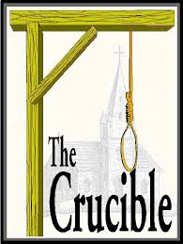
The Crucible
Arthur Miller

Slide 2
Activity Groups
Research People & Things That Are Feared in Society: Group One: People & Things in the early settlement era (1600s) Group Two: People & Things during the Red Scare era (1950s) Group Three: People & Things today Create a visual presentation detailing the people & things feared during that time AND the underlying reasons that serve as the basis for that fear Conduct a “Gallery Walk of Fear”

Slide 3
Fear in the 1600s
▪ Witches ▪ Wizards ▪Disease ▪ Pagans ▪“Indians”
▪ The Forest ▪Travel ▪ Winter
▪ Satan / Devil ▪ Starvation
▪ New Ideas ▪ The Court ▪ Child Birth

Slide 4
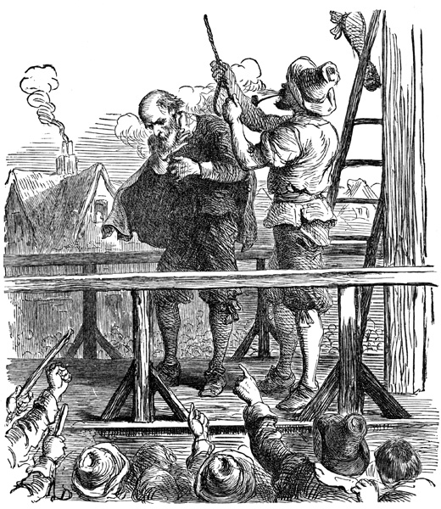
“justice” in the 1600s

Slide 5
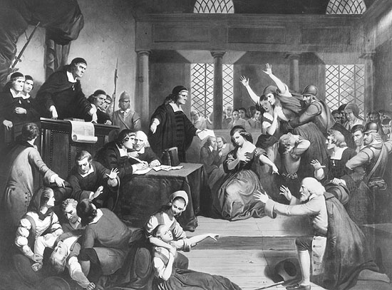

Slide 6
The Forest was Satan’s playground…

Slide 7
CULTURAL TIMELINE OF THE 1600s

Slide 8
SALEM WITCH TRIALS INTERACTIVE MAP

Slide 10
Fear in the 1950s
▪ Communism ▪ Nuclear War
▪ The End of the Family ▪ Russia
▪ China ▪ Desegregation ▪Polio
▪Another World War ▪ Birth Contro
▪ New Ideas ▪ Immigrants

Slide 11
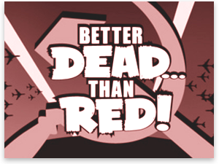
How to spot a communist

Slide 16
Fear Today
▪ Terrorists ▪ Chemical War
▪ Economic Collapse ▪ Unemployment
▪ China ▪ Desegregation ▪ Technology
▪ Gay Marriage ▪ Global Warming
▪ New Ideas ▪ Immigrants

Slide 17
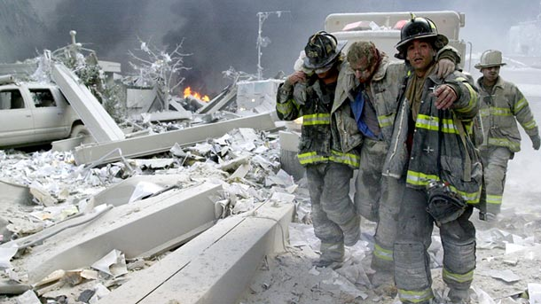

Slide 18
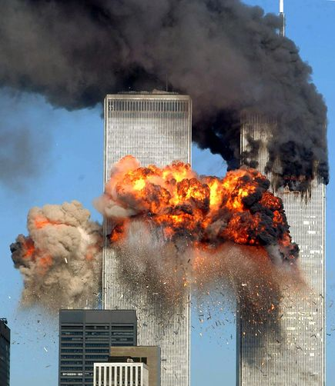

Slide 21
Activity #5
Read the prose passages from Act I of The Crucible Take a Senteo quiz on the prose passage (first four pages of Act I) Come to class with the following: 1. a written definition of the concept of “siege mentality” 2. at least 3 quotes from last night’s reading that illustrate this concept 3. at least 2 pictures that visually depict the concept of “siege mentality” In a group of 2 or 3, create a poster using the materials you brought to class Add them to the Fear Gallery

Slide 22
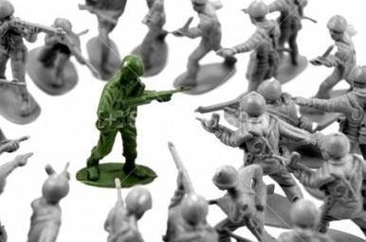
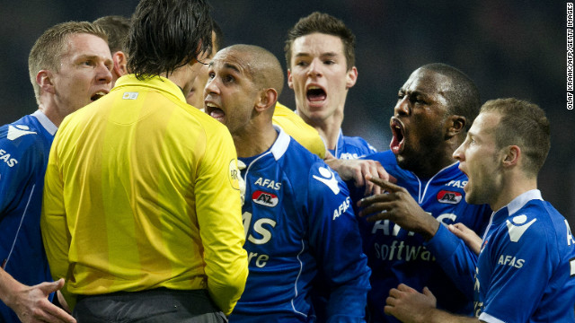
Siege Mentality
Definition: (noun) a feeling that you are in constant danger or are surrounded by enemies

Slide 24
Arthur miller
Born in Harlem, New York, October 17, 1915
Died at age 89 in 2005

Slide 25
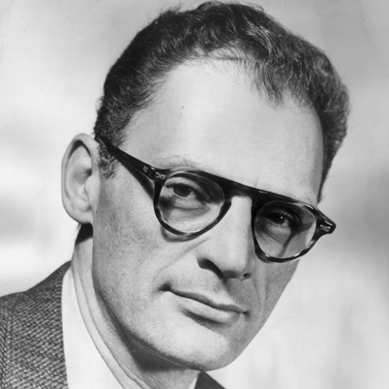
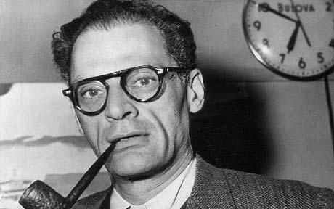

Slide 26
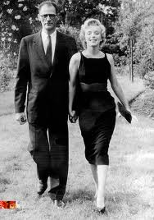
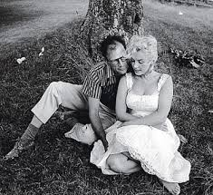

Slide 27
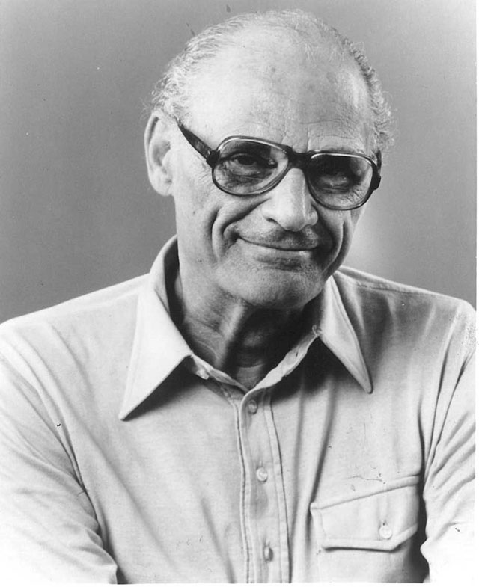

Slide 28
Arthur Miller
1929 – Stock market crashes, family in turmoil, no money for college
1940 – The Man Who Had all the Luck: terrible critic reviews
1946 – All my Sons: success on Broadway; earned Tony Award (Best Author)
1949 – Death of Salesman: huge success; earned triple crown of theatrical artistry
1956 – Divorced first wife, married Marilyn Monroe, began The Crucible
1957 - The House of Un-American Activities Committee refused to renew Miller's passport, and called him in to appear before the committee. This was due to his latest work, The Crucible, and the allegations that he was a communist
1961 – Wrote screenplay for Monroe’s film The Misfits shortly before divorcing Monroe
1968 – Final successful play, The Prince, was released

Slide 29
Sen. McCarthy
Born in Grand Chute, Wisconsin, November 14, 1908
Died at age 48 in 1957

Slide 30
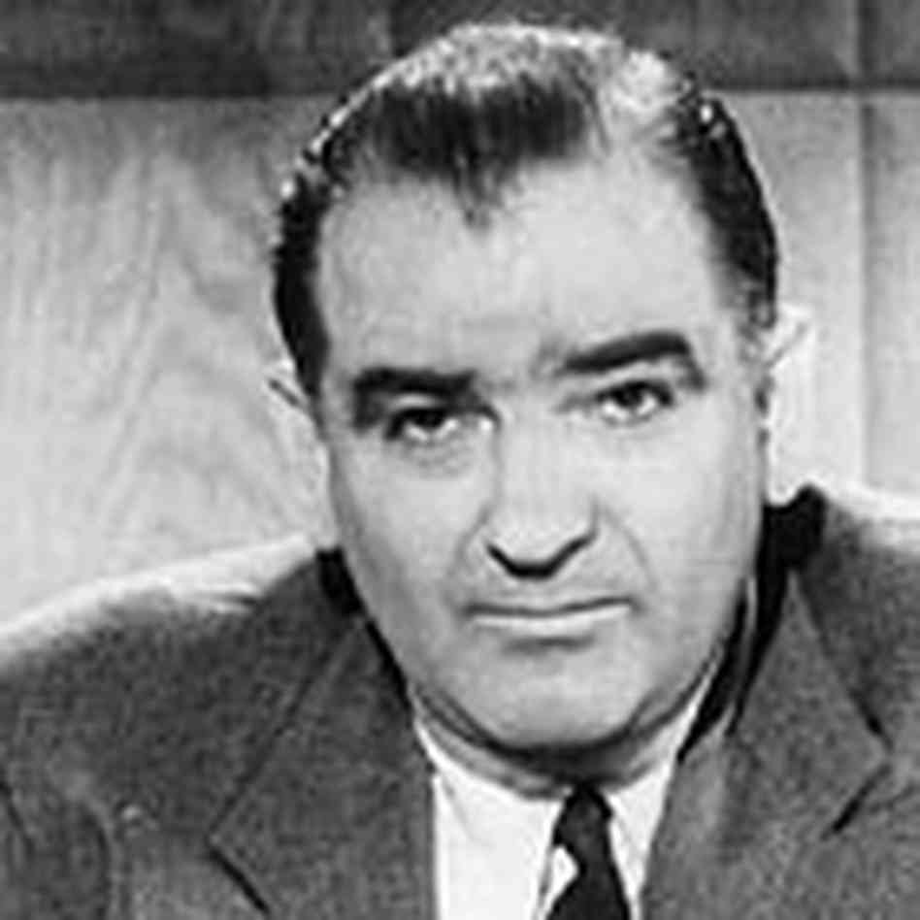
Red Scare - A period of general fear of communists
McCarthyism - Anti-Communist who felt that communists should be removed from the United States in order to keep democracy safe

Slide 31
Public opinion
McCarthy's Support in Gallup Polls
Date | Favorable | No Opinion | Unfavorable | Net Favorable
1951 August | 15 | 63 | 22 | −7
1953 April | 19 | 59 | 22 | −3
1953 June | 35 | 35 | 30 | +5
1953 August | 34 | 24 | 42 | −8
1954 January | 50 | 21 | 29 | +21
1954 March | 46 | 18 | 36 | +10
1954 April | 38 | 16 | 46 | −8
1954 May | 35 | 16 | 49 | −14
1954 June | 34 | 21 | 45 | −11
1954 August | 36 | 13 | 51 | −15
1954 November | 35 | 19 | 46 | −11

Slide 34
Salem witch trials
Salem Witch Trials began March 1, 1692.
Women of a variety of ages, some as young as four, were accused of being witches
Many men were also tried as wizards.
Trials usually resulted in an execution, very few accused were actually released alive.
Executions were by hanging, and not in fact by burning as many people believe.
One man was crushed to death for not entering a plea of guilty or not guilty

Slide 35
Salem Massachusetts

Slide 36
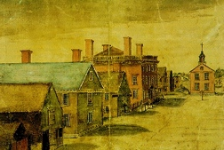
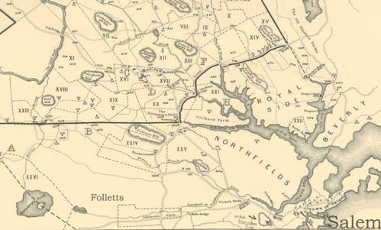
Salem Massachusetts

Slide 37
TERMS YOU SHOULD KNOW…
wagon scaffold
Goody poppet

Slide 38
Wagon:

Slide 39
Scaffold:

Slide 40
Goody Nurse:

Slide 42
Poppets
Poppets were essentially puppets or voodoo dolls that were used in witchcraft. They were a key part of the executions, especially for the first execution of Bridget Bishop. The typical poppet was made of rags and hog bristles.

